Slide 1
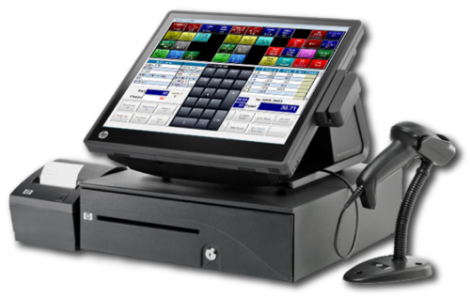
ODOO TRAINING REPORT
POS
(Point of sale)
Reporter: Phan Van Phuoc Thinh
Email: thinh.pvp@vn.vinx.asia

Slide 2
Structure:
Overview
Function of Odoo Point of Sale
Demo Point of Sale
Summary

Slide 3
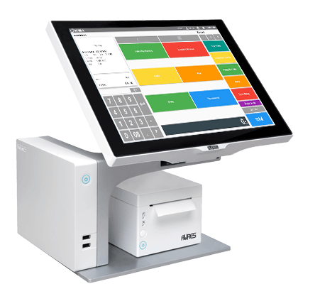
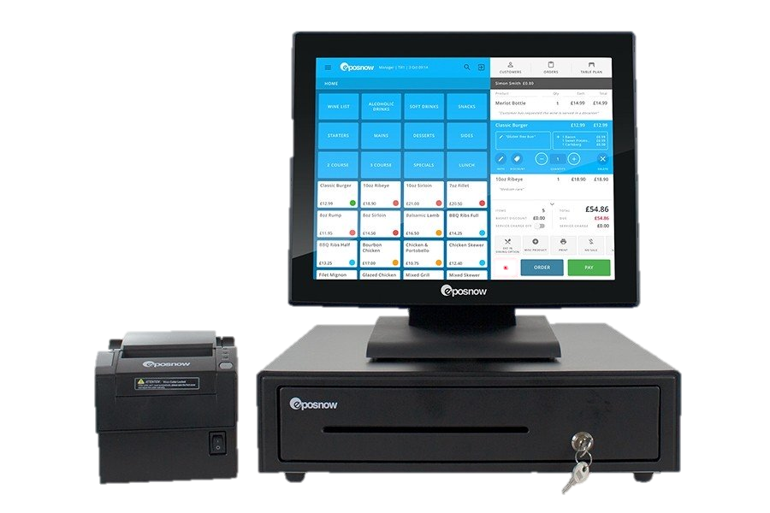
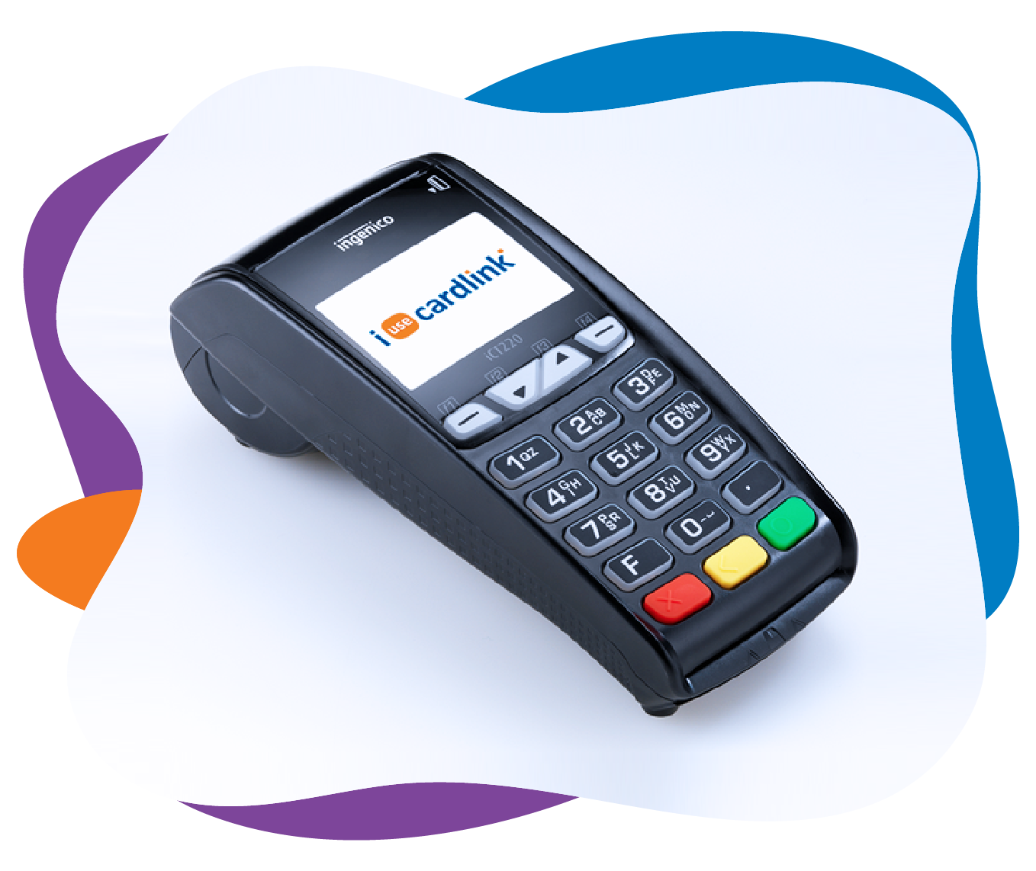
Overview
A point of sale system, or POS, is the place where your customer makes a payment for products or services at your store. Simply put, every time a customer makes a purchase at your store, they’re completing a point of sale transaction.

Slide 4
Overview
A point of sale system, or POS, is the place where your customer makes a payment for products or services at your store. Simply put, every time a customer makes a purchase at your store, they’re completing a point of sale transaction.
Odoo's online Point of Sale application is based on a simple, user friendly interface. The Point of Sale application can be used online or offline on iPads, Android tablets or laptops.
Odoo Point of Sale is fully integrated with the Inventory and Accounting applications. Any transaction in your point of sale will be automatically registered in your stock and accounting entries but also in your CRM as the customer can be identified from the app.

Slide 5
Overview
You will be able to run real time statistics and consolidations across all your shops without the hassle of integrating several external applications.

Slide 6
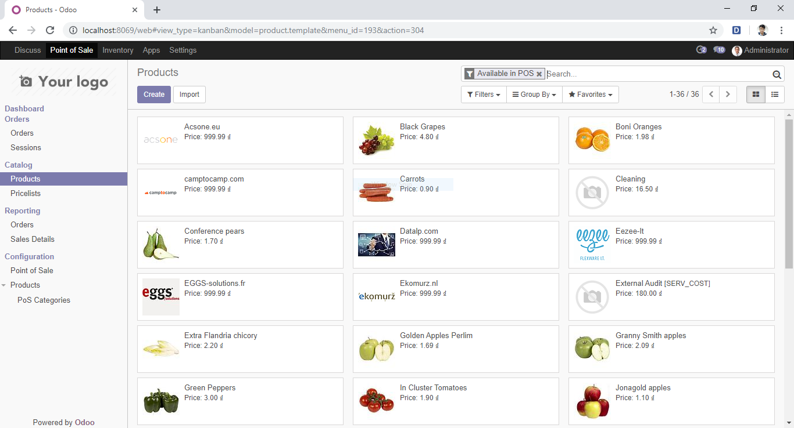

Slide 7
Function of Odoo Point of Sale
POS configuration
POS orders
POS reports
Inventory
POS

Slide 8
Demo Point of Sale
1. Create a customer
Registering your customers will give you the ability to grant them various privileges such as discounts, loyalty program ...
It will also be required if they want an invoice and registering them will make any future interaction with them faster.

Slide 9
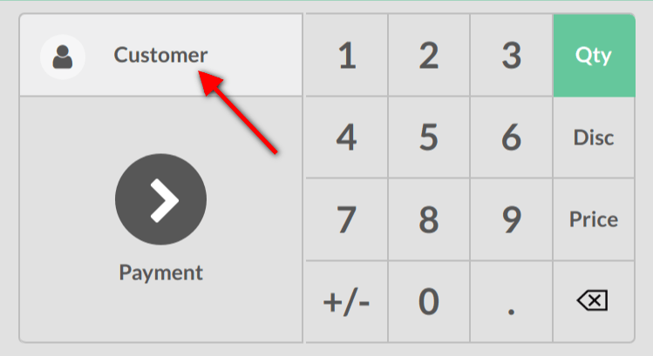
Demo Point of Sale
1. Create a customer

Slide 10
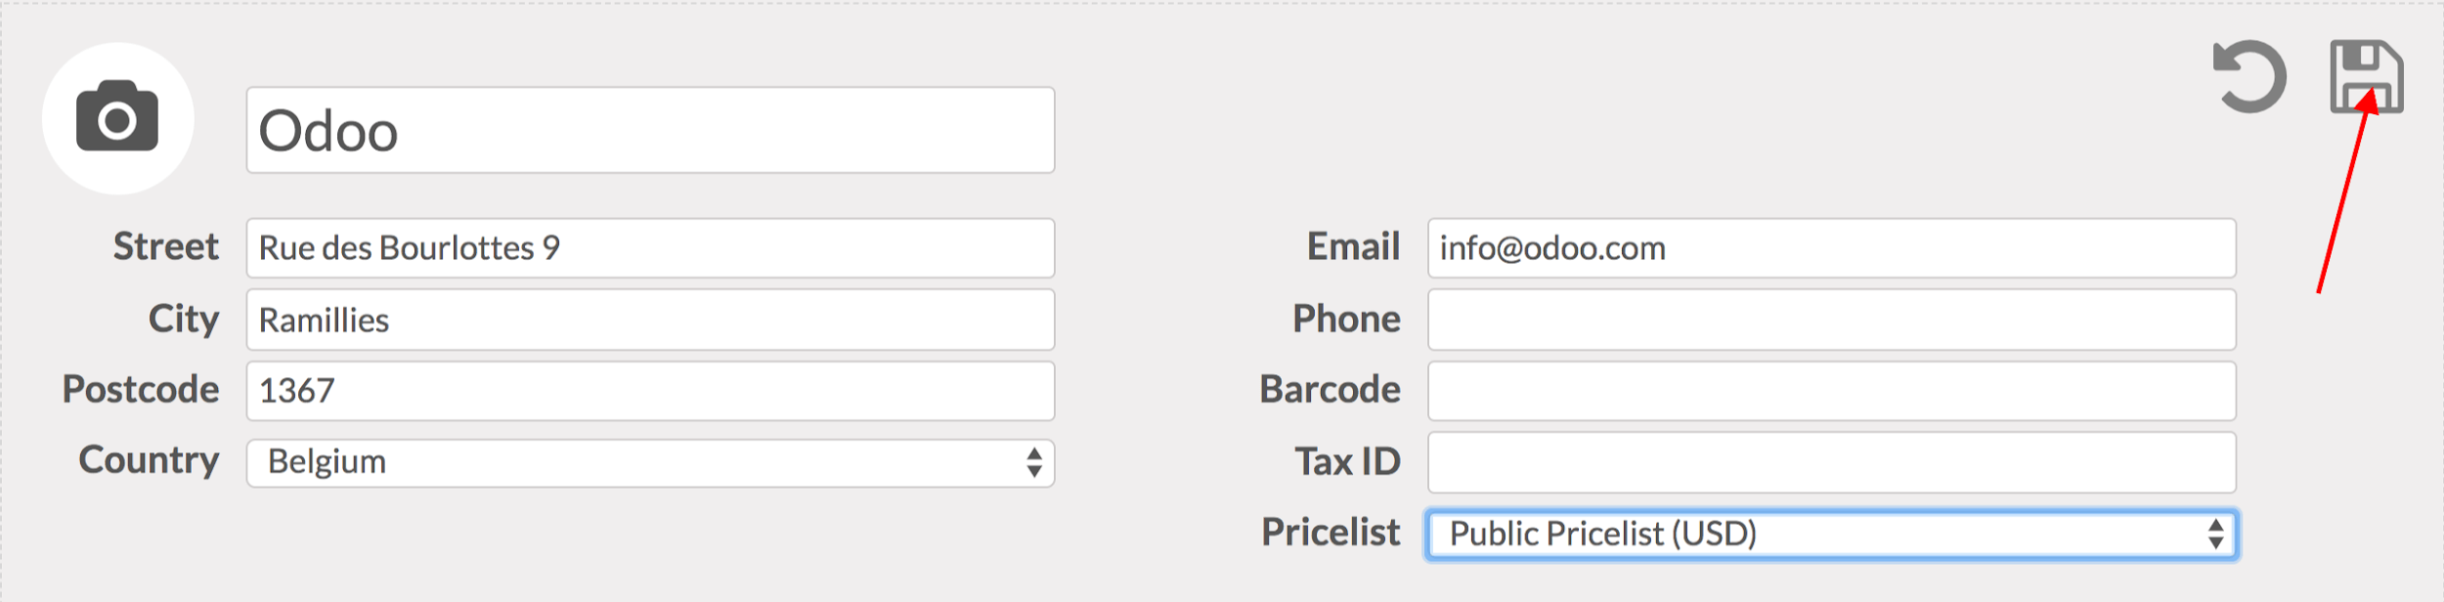
Demo Point of Sale
1. Create a customer

Slide 11
Demo Point of Sale
2. Activate invoicing

Slide 12
Demo Point of Sale
1

Slide 13
Demo Point of Sale
1

Slide 14
Demo Point of Sale
1

Slide 15
Demo Point of Sale
1

Slide 16
Demo Point of Sale
1

Slide 17
Demo Point of Sale
1

Slide 18
Demo Point of Sale
1

Slide 19
Demo Point of Sale
1

Slide 20
Demo Point of Sale
1

Slide 21
Demo Point of Sale
1

Slide 22
Demo Point of Sale
1

Slide 23
Demo Point of Sale
1

Slide 29
Summary

